Slide 1
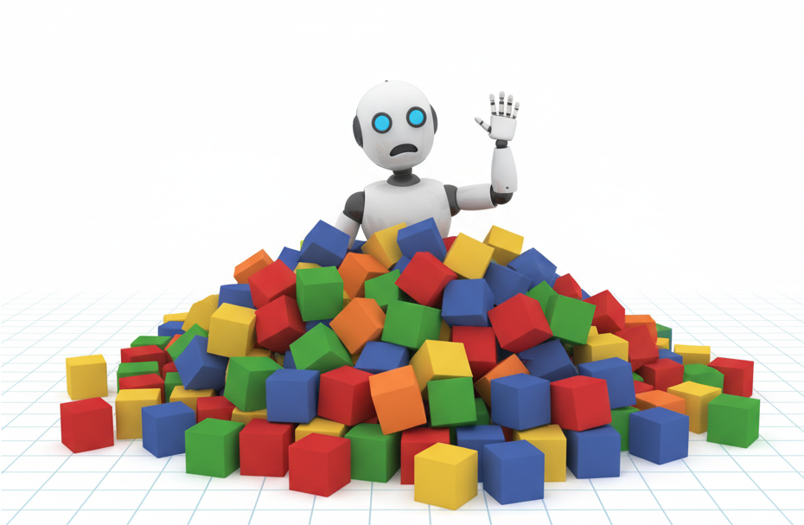
Automating Thought of Search:
A Journey Towards Soundness and Completeness
ICAPS 2026
Daniel Cao* Michael Katz Harsha Kokel Kavitha Srinivas Shirin Sohrabi
Cornell University IBM
*Work performed while at IBM

Slide 2
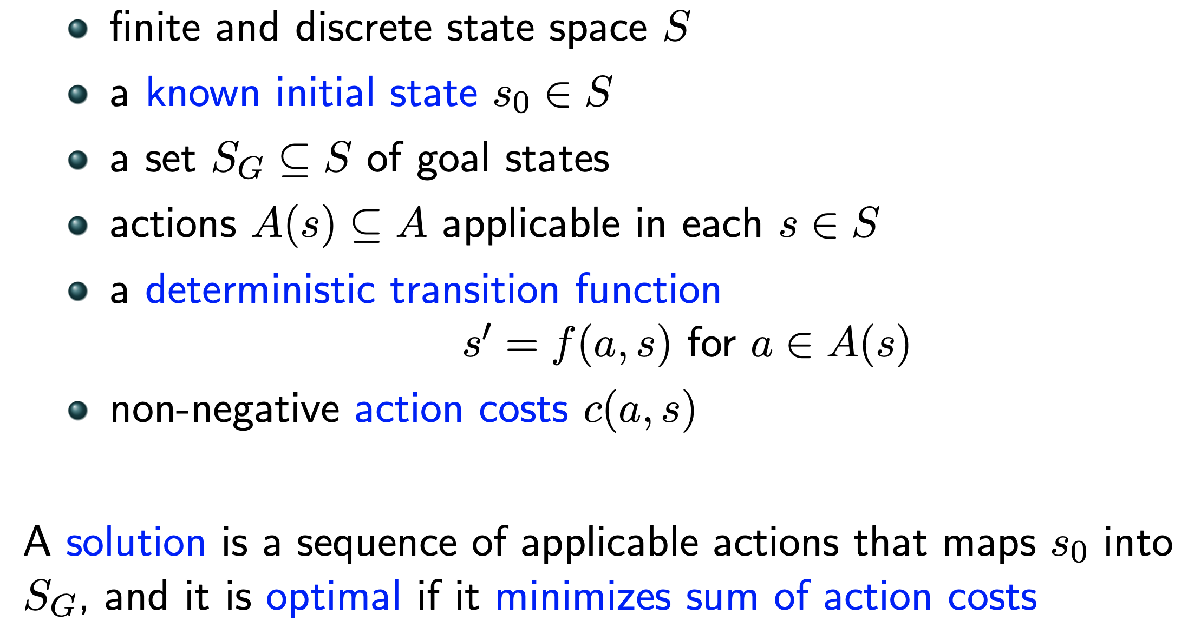
Planning problem
The 24 Game is a mathematical card game in which the objective
is to find a way to manipulate four integers so that the end result is 24.
The game is played with a list of four numbers, and the player must use all four numbers exactly once, using any combination of addition, subtraction, multiplication, or division, to arrive at the number 24.
Mathematical Model:
Planning Language
types
objects
predicates
initial state
actions
goal
preconditions
effects
Black Box
goal: S -> {T,F}
succ: S ->2^{SxA}

Slide 3
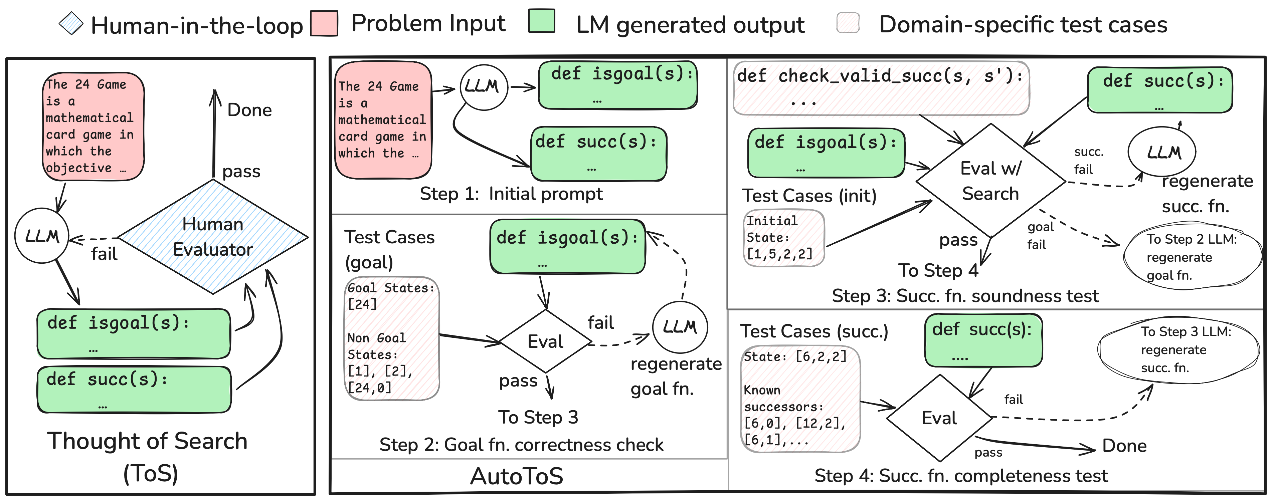
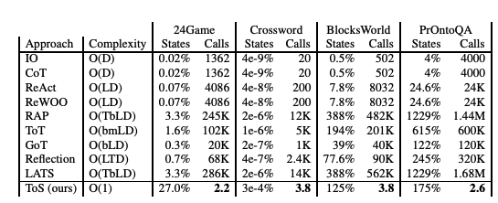
Background: Solving NL/PDDL Planning Problems: ToS
Plug the functions into a standard search (BFS/DFS/IDDFS…)
Results?
100% accuracy across all tested domains!
Execution time in ms per instance
Limitation: need human in the loop!
Katz et al, NeurIPS 2024

Slide 4

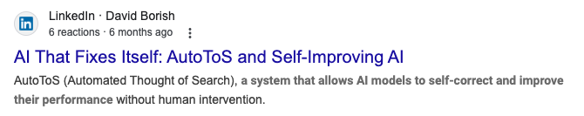


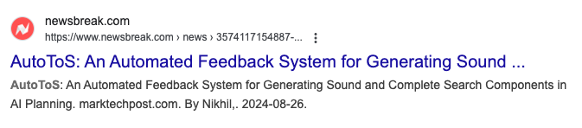
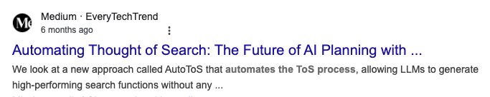

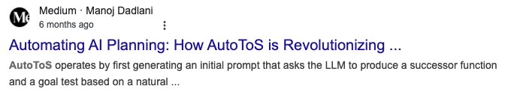
Solving NL/PDDL Planning Problems: AutoToS

Slide 5
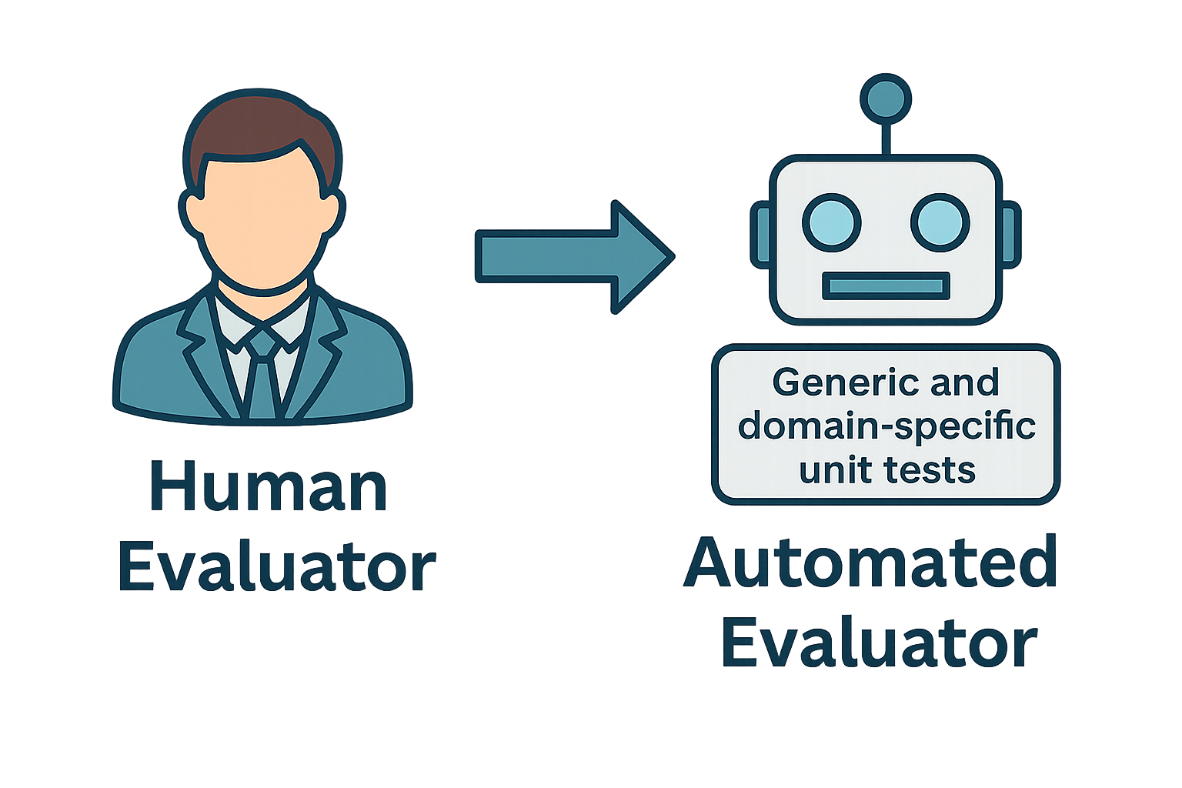
AutoToS: Core Idea

Slide 6
How does it work?

Slide 7
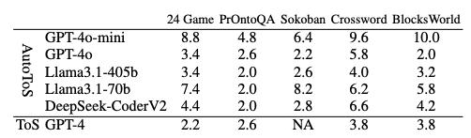
Is it much worse than a human feedback?

Slide 8
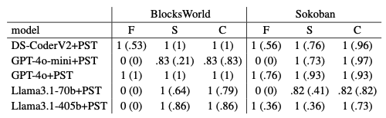
Does it match the accuracy of ToS?

Slide 9


